Slide 1
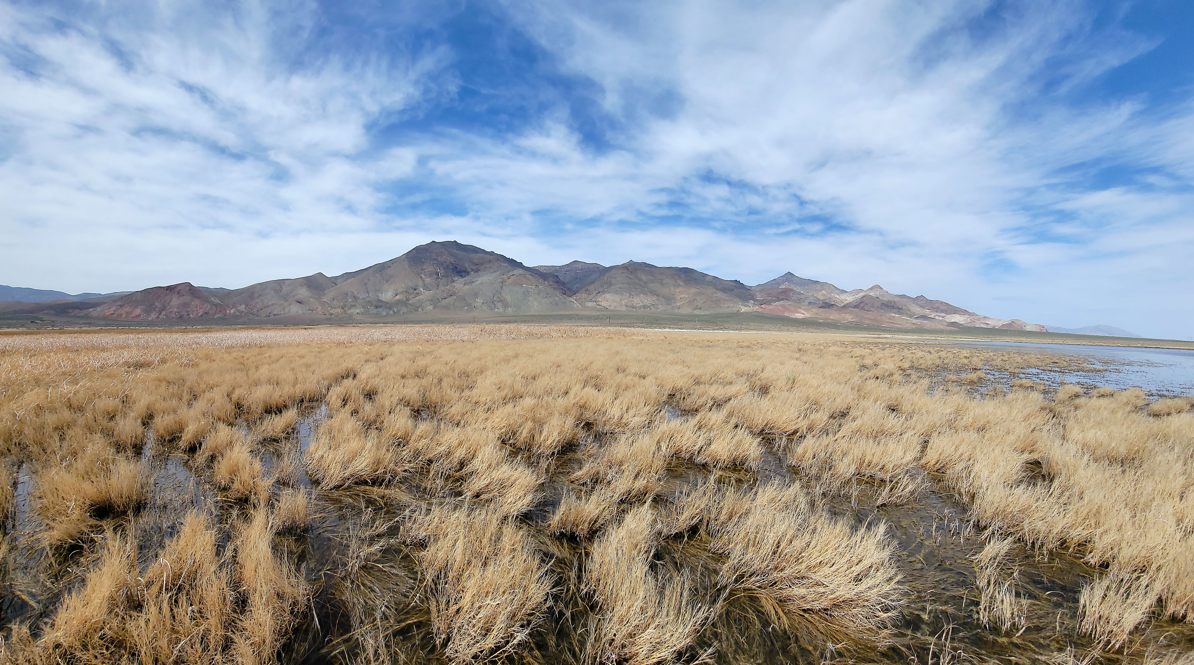
Rate & Direction of Spreading in Dixie Valley, Basin & Range Province, Nevada
Paper by Thompson & Burke
Presentation by Solomon Feinstein

Slide 2
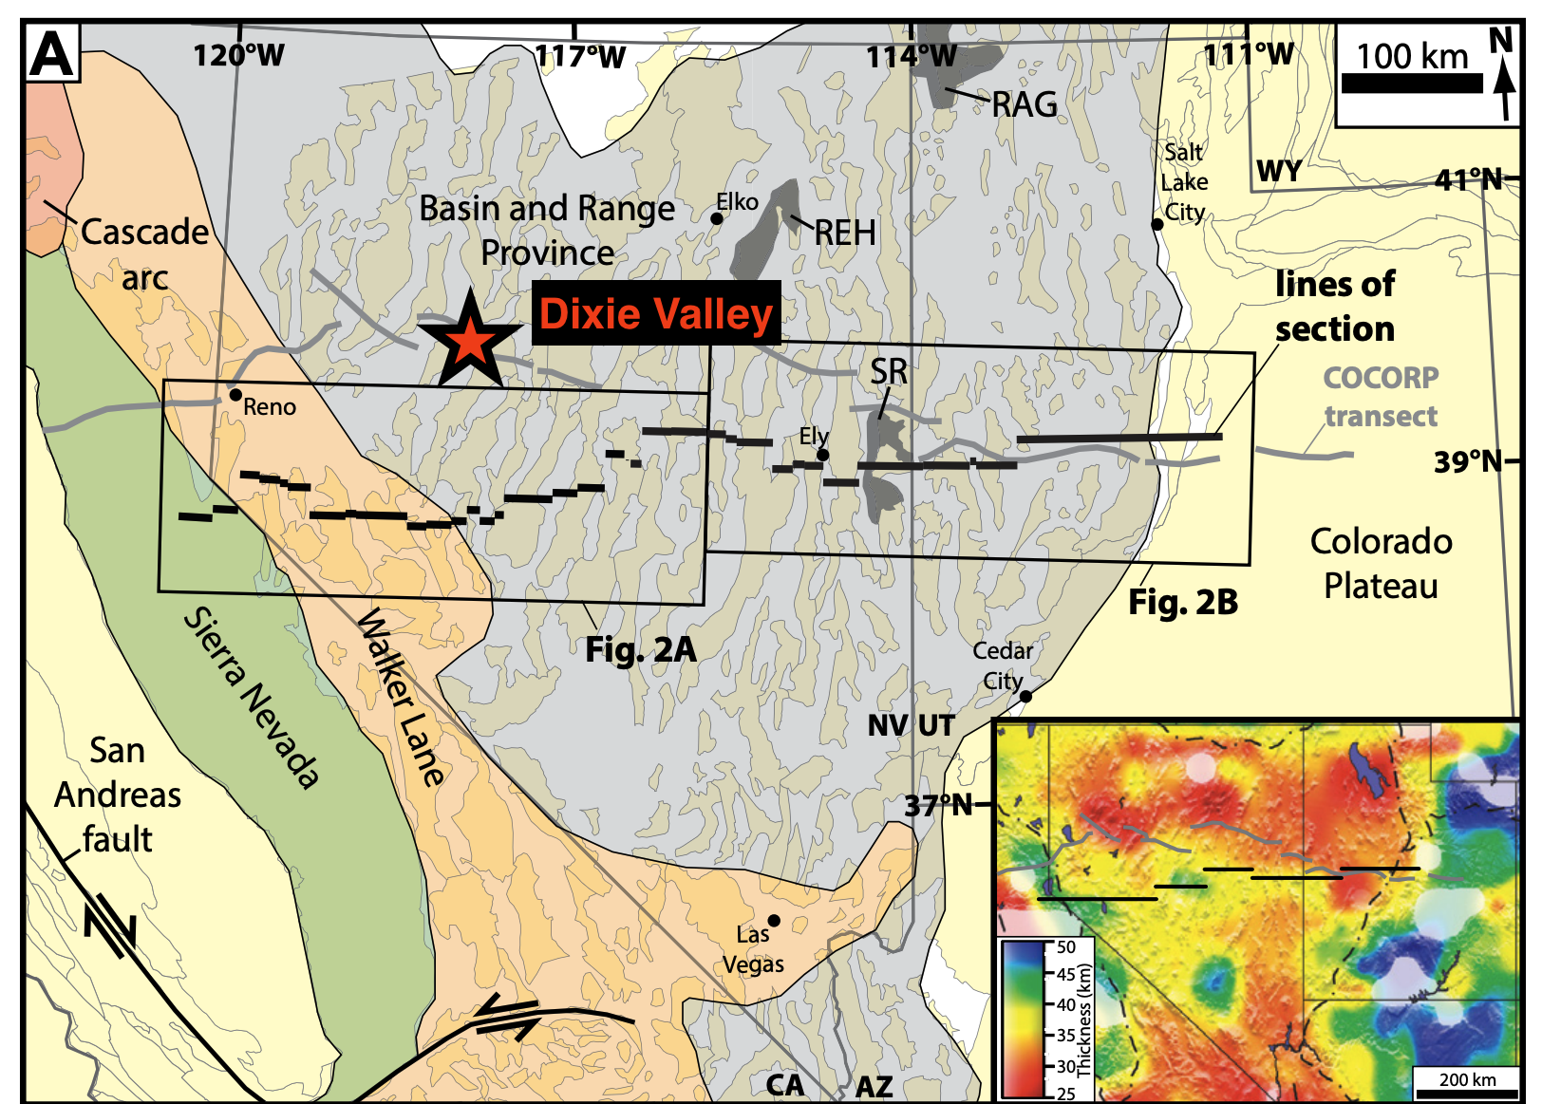
Why?
Basin & Range Province has been actively extending for at least the last 15 MY
Dixie Valley, located in western Nevada, is an excellent microcosm of the Basin & Range that can be utilized to further understand crustal extension in the region
This study seeks to quantify the rate and magnitude of extension in the Basin & Range by doing just that in the Dixie Valley
Figure from Long (2019)

Slide 3
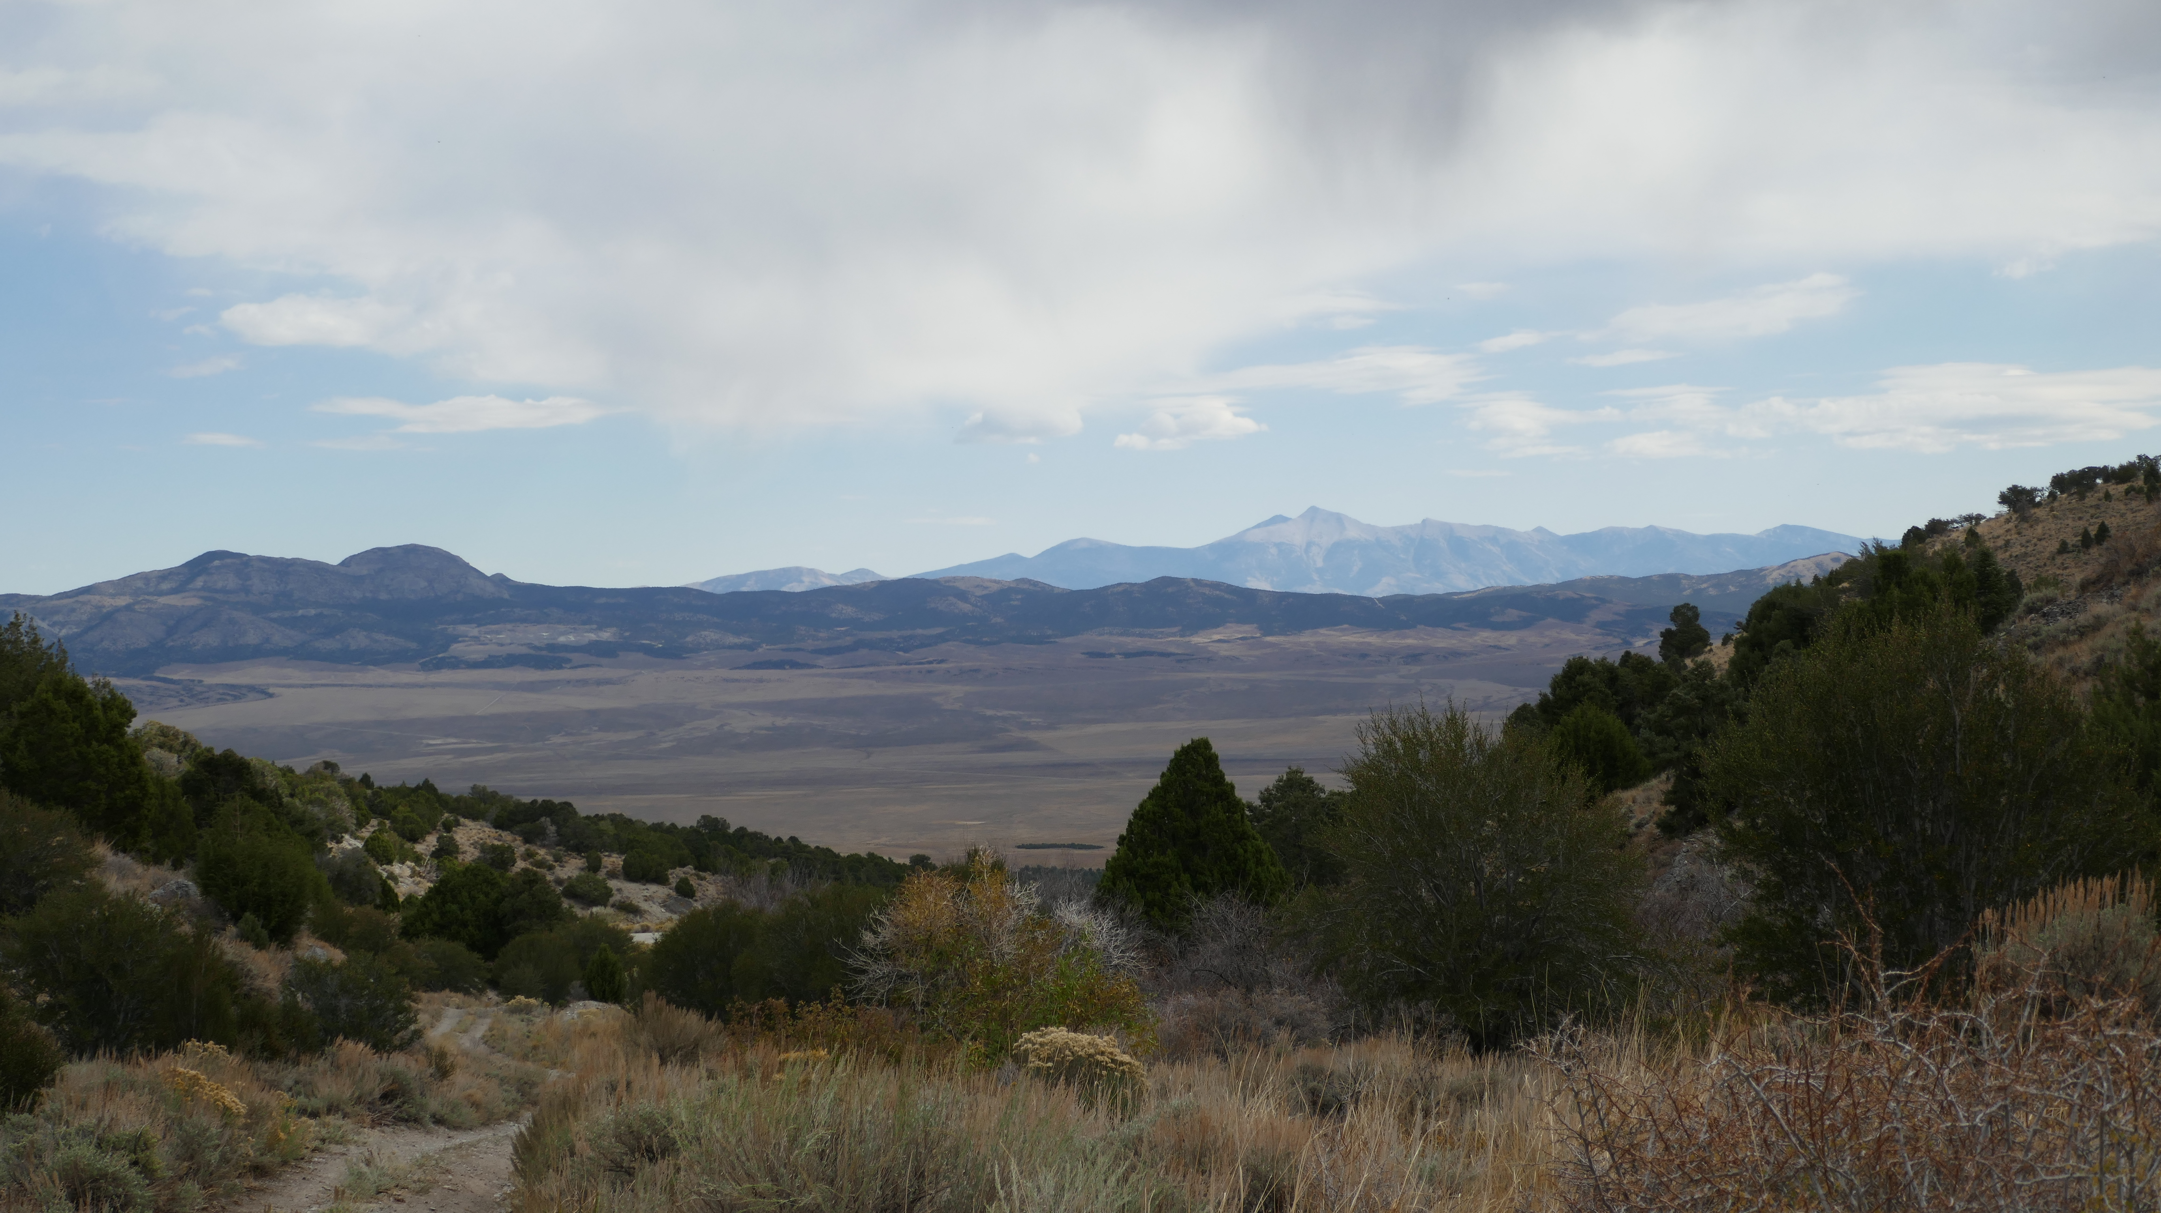

Slide 4
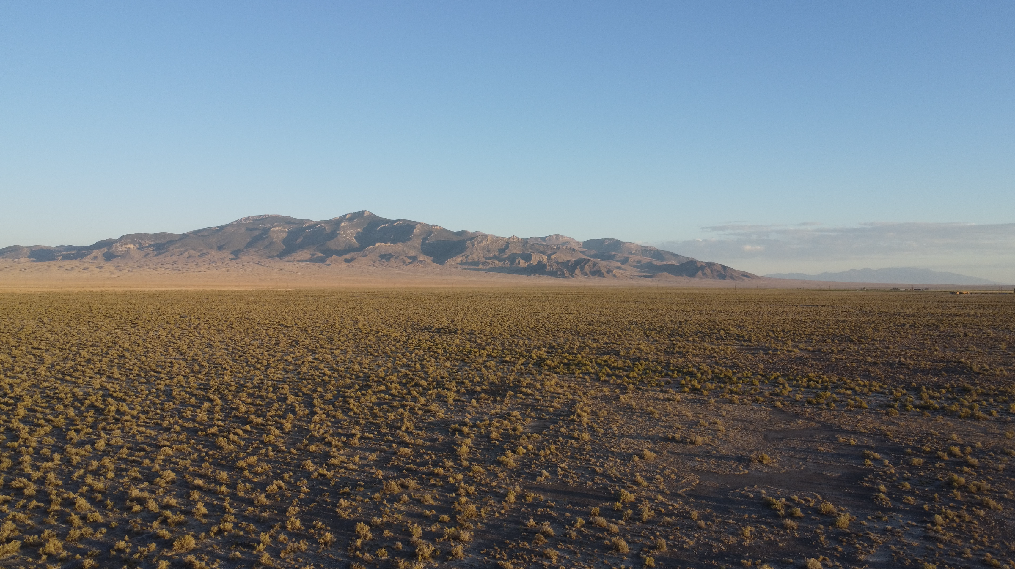

Slide 5
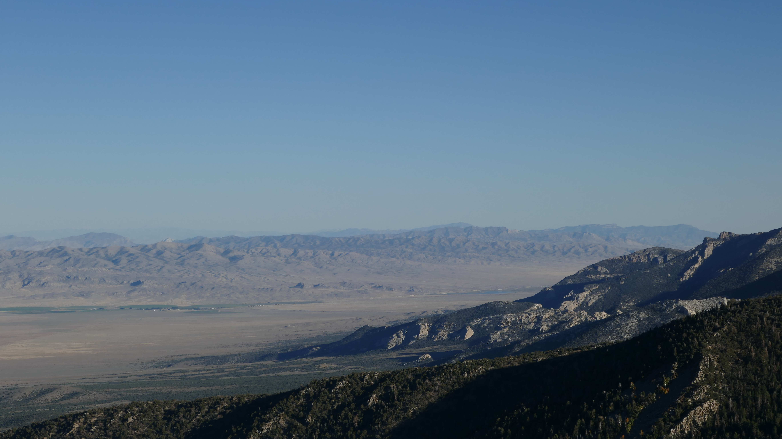
Methods
This study utilizes 3 measurements to extrapolate fault offset in Dixie Valley
Geodesy/Geodetic Measurements
Displacements of Pleistocene Lake shoreline
Fault displacements/Geophysical Exploration
Additionally, fault grooves were analyzed to extrapolate fault characteristics, and comparative data from other BR localities was utilized

Slide 6
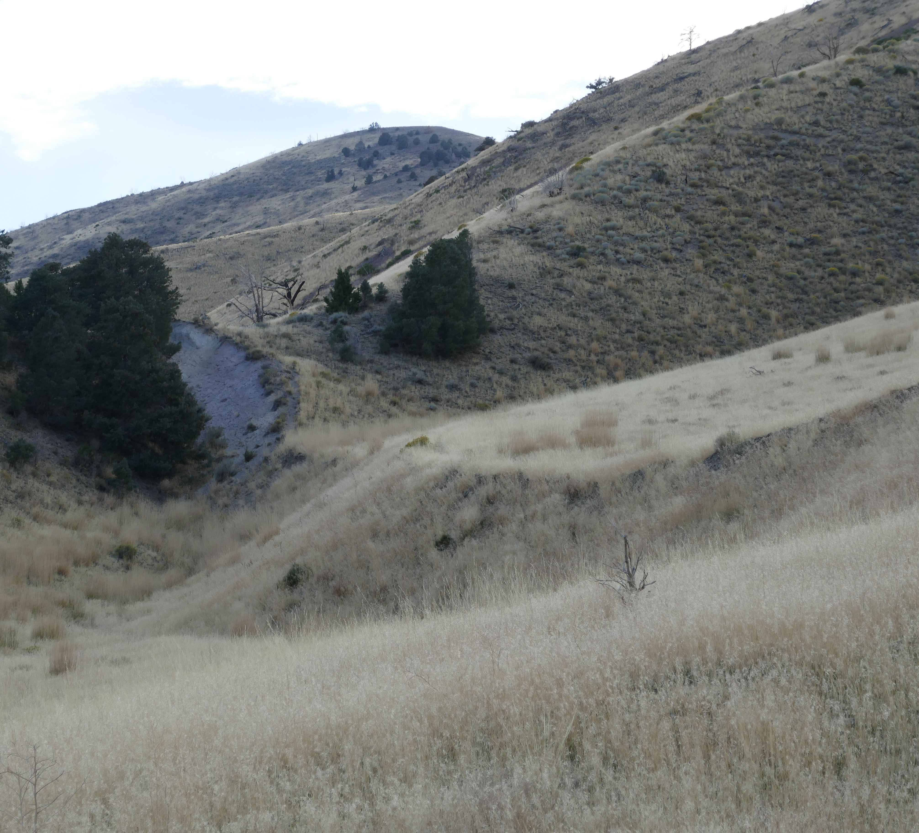
Geodetic Measurements
Earthquakes associated with this basin occurred in 1903, 1915, & 1954
The 1954 faulting showed an abrupt elastic rebound of 1.5 m, as well as a strike of N15ºE
Displacements of this magnitude occur roughly every 1,000 years, making the average spreading rate of the Dixie Valley roughly 1.5 mm/yr

Slide 7
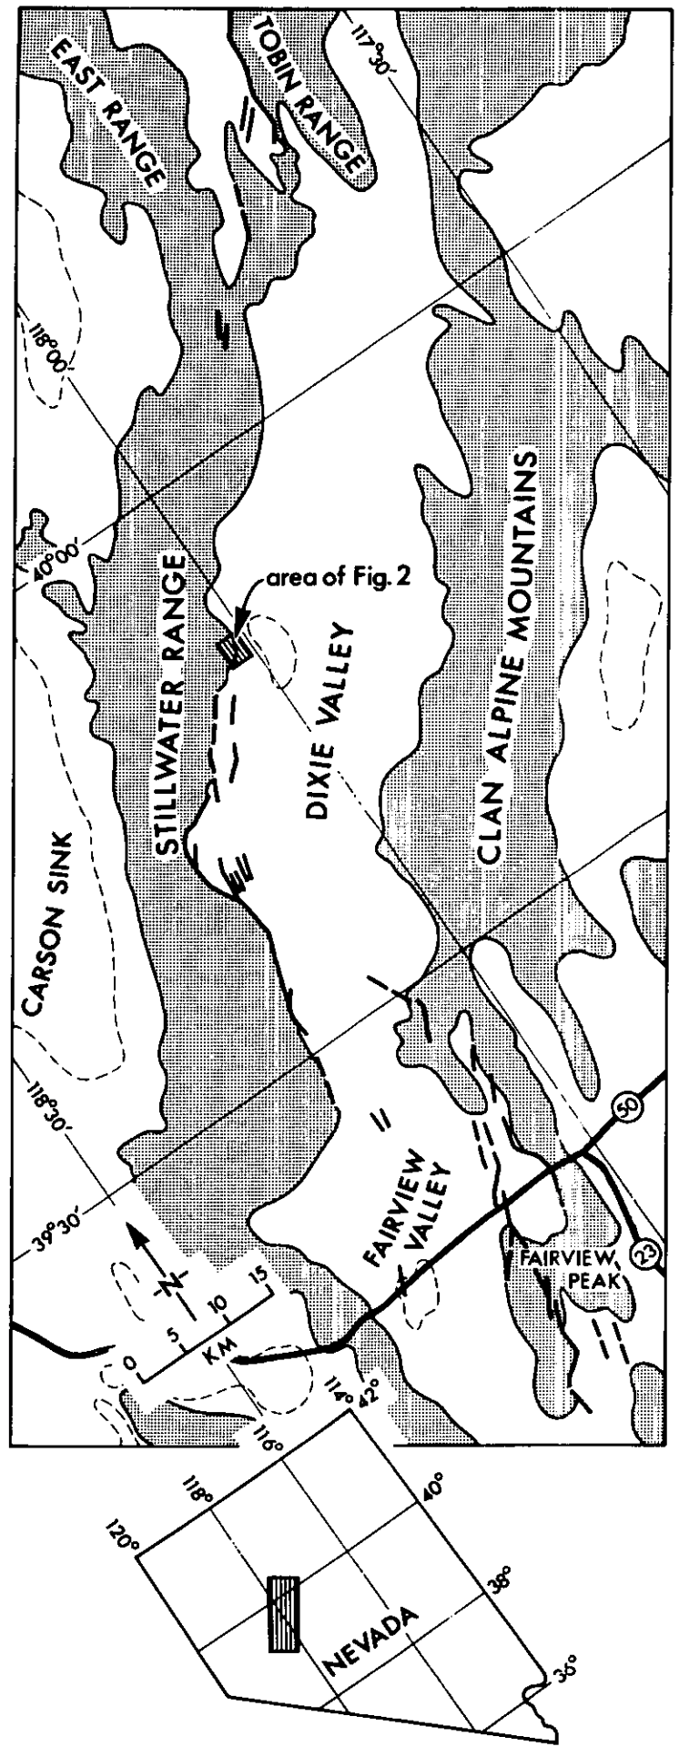
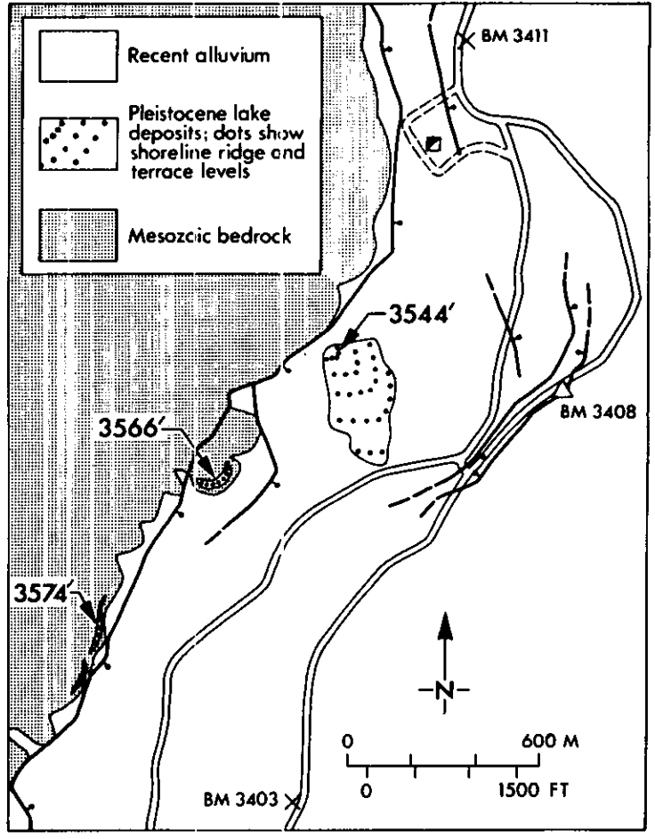
Pleistocene Shoreline
A Late Pleistocene Lake existed in Dixie Valley
Gravel-beach ridges record paleoshorelines, as do “bathtub rings” of calcareous tufa
The highest paleoshoreline stands at an elevation of 3,585’
Two samples of calcareous tufa were collected from here and dated via C-14
The samples date back to 11,560 & 11,700 +/- 180 yrs BP, these dates corresponding to tufa dates from the high shorelines of Lake Lahontan
Shoreline deposits are cut by several faults, most dipping 60º
Vertical displacement of 9 m and horizontal extension of 10 m in the last 12,000 years was recorded, averaging out to a rate of 1 mm/yr of extension

Slide 8
Geophysical Exploration
Refraction seismology, gravity measurements, & magnetic depth estimates were used to determine bedrock geometry of the valley and subsurface faults
Total vertical displacement: > 5km
Total horizontal extension: > 6km
Estimated timeframe of commencement of geologic activity: 15 MA
Spreading rate: 0.4 mm/yr

Slide 9
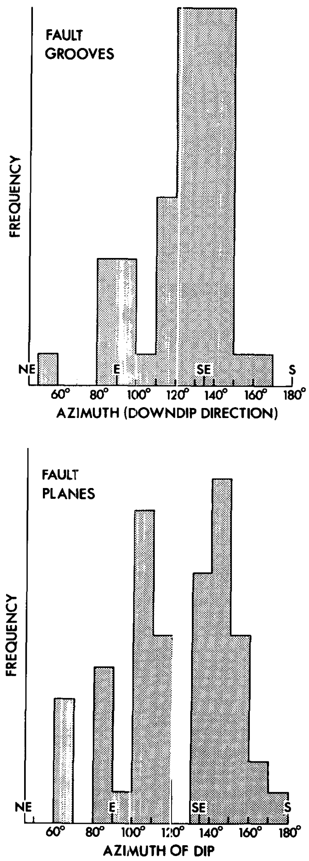
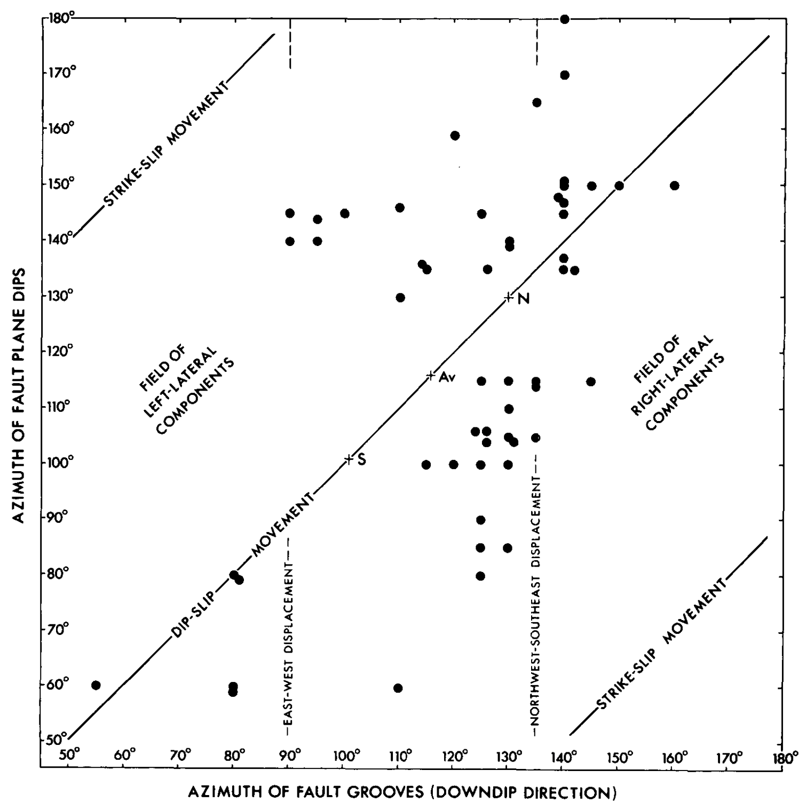
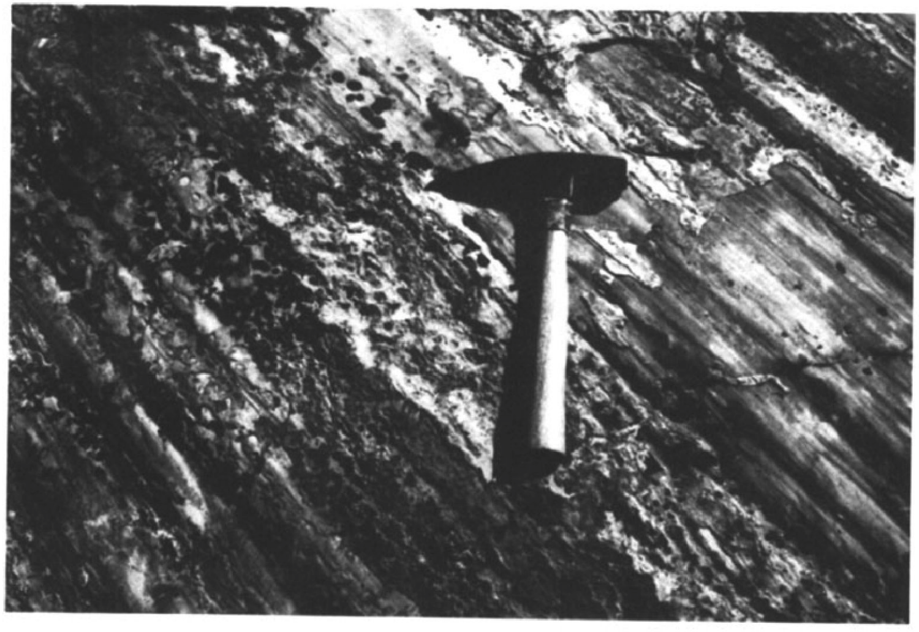
Fault Grooves
No consistent horizontal component of displacement was observed in 1954 earthquake, but many older fault surfaces are well exposed and showcase grooves, giving a reliable measure of relative motion over time
The grooves are mainly zigzagged- as such, some lateral displacement should be expected
This is exactly what is observed
N/S striking faults show a component of dextral (right-lateral) slip
NE/SW striking faults show a component of sinistral (left-lateral) slip
Measurements of grooves are found and compiled- the mean azimuth is just west of NW/SW, indicating spreading
The area is almost evenly divided between Normal/LL faults & Normal/RL faults. Pure dip-slip is rare, and pure strike-slip faults were not found
Notes:
Mean attitude is 125º or N55ºW-S55ºE

Slide 10
Conclusions
For the last 15 MY, Dixie Valley has been spreading
Average rate: 4 mm/yr
Rate since 12,000 BP: 1 cm/yr
The spreading direction is N55ºW-S55ºE
Almost all normal faults in the valley show oblique slip, be it dextral (N/S striking faults) or sinistral (NE/SW striking faults)
The spreading direction seems to be consistent across the entire Basin & Range (as seen by Genoa comparative study where faults show N60ºW-S60ºE)
When extrapolated to the entire Basin & Range, the 5 km of spread in Dixie Valley suggests a total spread of 100 km- a 10% increase in crustal area

